Slide 1

Virtualization and Cloud Computing
Understanding the Future of Computing

Slide 2

Introduction to Virtualization
Definition of Virtualization
Creating a virtual version of something (hardware, OS, storage, network resources).
Importance of Virtualization
Resource efficiency, scalability, and isolation.

Slide 3

Types of Virtualization
Hardware Virtualization: Use of hypervisors to create VMs (e.g., VMware, Hyper-V).
OS Virtualization: Containers (e.g., Docker, LXC).
Network Virtualization: Creating virtual networks and services.
Storage Virtualization: Abstracting multiple storage resources into one.

Slide 4

Benefits of Virtualization
Cost Savings: Reduced hardware costs and better resource utilization.
Flexibility and Scalability: Easy to scale resources up or down.
Disaster Recovery: Faster recovery times and easier backups.
Isolation: Improved security and application separation.

Slide 5
Server Virtualization Platforms
VMware vSphere/ESXi: A widely-used enterprise-grade virtualization platform that includes the ESXi hypervisor for creating and managing virtual machines.
Microsoft Hyper-V: A virtualization platform included with Windows Server that enables the creation and management of virtual machines.
KVM (Kernel-based Virtual Machine): An open-source virtualization technology integrated into the Linux kernel that turns the kernel into a type-1 (bare-metal) hypervisor.
Xen: An open-source hypervisor that supports both paravirtualization and hardware virtualization.
Oracle VM VirtualBox: A free and open-source virtualization solution for x86 and AMD64/Intel64 platforms, often used for desktop virtualization.
Proxmox VE: An open-source platform for enterprise virtualization based on KVM and LXC, offering both virtual machines and containers.

Slide 6

Desktop Virtualization Platforms
VMware Workstation Pro: A powerful desktop virtualization solution for running multiple operating systems on a single PC.
Parallels Desktop: A popular choice for Mac users to run Windows and other operating systems alongside macOS.
Citrix Virtual Apps and Desktops: Provides virtual desktop infrastructure (VDI) for delivering apps and desktops to users.

Slide 7

Cloud Virtualization Platforms
Amazon Web Services (AWS) EC2: Provides resizable compute capacity in the cloud using virtualization technology.
Microsoft Azure: Offers various services including virtual machines and other cloud services built on virtualization technologies.
Google Cloud Platform (GCP): Includes services like Google Compute Engine that allows users to create and run virtual machines on Google's infrastructure.
IBM Cloud: Offers both IaaS and PaaS solutions with virtualization capabilities.

Slide 8
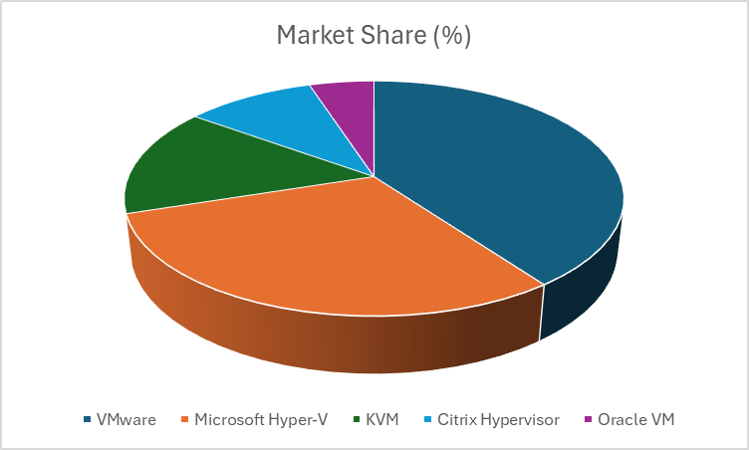
Market Share by Virtualization Platform

Slide 9

Introduction to Cloud Computing
Delivery of computing services (servers, storage, databases, etc.) over the internet.

Slide 10
Service Models
IaaS (Infrastructure as a Service)
PaaS (Platform as a Service)
SaaS (Software as a Service)

Slide 11

Deployment Models of Cloud Computing
Public Cloud: Shared infrastructure hosted by third-party providers (e.g., AWS, Google Cloud).
Private Cloud: Dedicated infrastructure for a single organization.
Hybrid Cloud: Combination of public and private cloud resources.

Slide 12

Benefits of Cloud Computing
Cost Efficiency: Pay-as-you-go pricing reduces upfront costs.
Accessibility: Access resources and applications from anywhere.
Scalability: Easily scale resources as needed.
Security: Advanced security features provided by cloud providers.

Slide 13
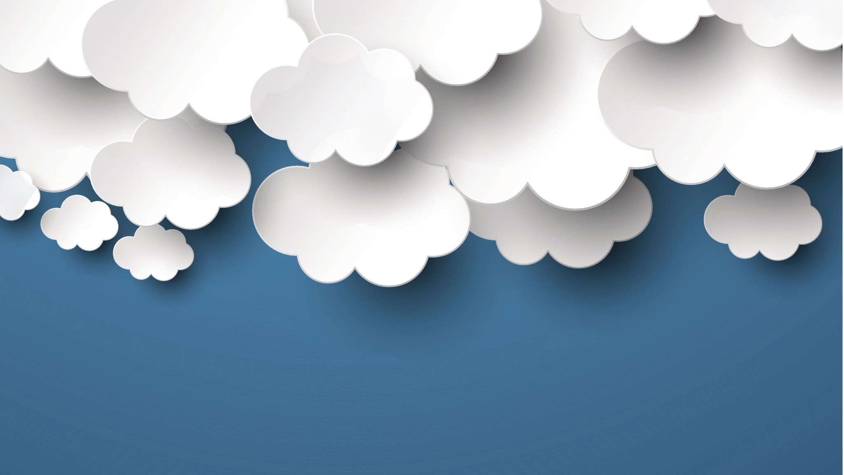
Virtualization in Cloud Computing
Role of Virtualization in Cloud Environments
Underpins cloud infrastructure enabling resource allocation.
Benefits of Using Virtualization in the Cloud
Efficient resource management and improved uptime.

Slide 14
Leading Cloud Computing Platforms
Amazon Web Services (AWS)
Market Share: Approximately 31% to 33%
Overview: AWS is a pioneer in the cloud computing industry, offering a comprehensive suite of services including computing power,
storage, machine learning, and networking solutions. It's well-regarded for its scalability, reliability, and extensive service offerings.
Microsoft Azure
Market Share: Approximately 20% to 22%
Overview: Microsoft's Azure offers a wide range of cloud services, including IaaS, PaaS, and SaaS. Its integration with Microsoft
products and services is a strong selling point, making it popular among enterprises.
Google Cloud Platform (GCP)
Market Share: Approximately 9% to 10%
Overview: GCP focuses on data analytics, machine learning, and AI services. It is known for its strong Kubernetes support
and big data processing capabilities.

Slide 15

Challenges and Considerations
Security Risks: Data breaches and unauthorized access.
Compliance: Meeting regulations and standards.
Downtime: Dependence on internet connectivity and service reliability.
Vendor Lock-In: Challenges when switching providers.

Slide 16
Future Trends
Edge Computing: Processing data closer to where it is generated.
Serverless Architectures: Focus on code rather than infrastructure management.
AI and Machine Learning Integration: Enhanced capabilities through intelligent resource management.

Slide 17

Conclusion
Recap of Virtualization and Cloud Computing.
Importance of these technologies in modern IT infrastructure.
Encouragement to adapt and leverage these technologies.

